Slide 1



BudgetBuddy
Team
Codettes

Slide 2
Agenda
Objectives
& Scope
Timeline
Features
Innovation &
Creativity
Depth of Understanding
Execution
&
Societal Impact
Feasibility &
Scalability

Slide 3

Objectives & Scope
BudgetBuddy aims to revolutionize financial management by providing individuals and entrepreneurs with personalized, AI-powered insights for real-time decision-making.
The platform simplifies financial forecasting, tracks investments, and offers goal-based recommendations to foster smarter financial habits.
---------------------------------------------------------------------
Its scope extends to empowering users with interactive visualizations, educational resources, and consultancy features, making it a one-stop solution for achieving financial well-being and long-term growth.

Slide 4
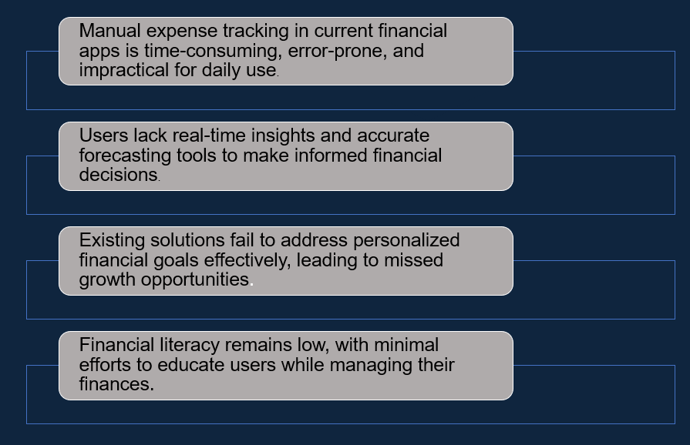
Problem
Manual expense tracking in current financial apps is time-consuming, error-prone, and impractical for daily use.
Users lack real-time insights and accurate forecasting tools to make informed financial decisions.
Existing solutions fail to address personalized financial goals effectively, leading to missed growth opportunities.
Financial literacy remains low, with minimal efforts to educate users while managing their finances.

Slide 5
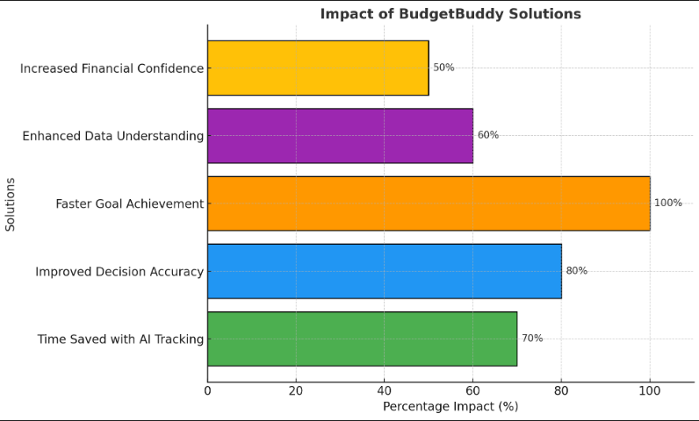
Solution
BudgetBuddy addresses financial management challenges with AI-driven automated tracking,
eliminating up to 70% of the time spent on manual entries. It provides real-time insights and accurate forecasts, enhancing decision-making by 80%.
Personalized, goal-based recommendations empower users to achieve financial milestones twice as fast, while dynamic visualizations with tools like Matplotlib and Chart.js improve data comprehension by 60%.
Additionally, integrated financial literacy modules aim to bridge knowledge gaps, boosting user confidence in managing finances by 50%.

Slide 6






Features
Interactive Visualizations
Goal-Based Recommendations
Financial Forecasting
Automated Expense Tracking
What-If Scenarios
Employs tools like Matplotlib, Chart.js, or D3.js to display data dynamically and intuitively.
Tailors personalized plans for savings, investments, and spending to achieve user goals.
Uses AI to predict future financial trends and outcomes.
Eliminates the need for manual input, saving time and improving accuracy.
Allows users to simulate different financial decisions and see potential impacts.

Slide 7
Creativity and Innovation
Personalized AI Solutions
Real-Time Forecasting & Generative Insights
Interactive What-If Scenarios
Gamified Financial Education
AI-Generated Financial Consultancy
Generative AI crafts tailored budgets, savings strategies, and investment paths, adapting to each user’s unique financial profile.
We provide financial forecasting by generating detailed scenarios and actionable insights for better decision-making.
Users explore simulated financial outcomes, generating real-time impact reports for informed choices.
GenAI creates personalized quizzes and challenges, making financial education engaging and effective.
Budget Buddy's AI-powered assistant offers 24/7 consultancy, providing instant, expert-like advice.

Slide 8

Additional Benefits
Real-Time Insights
Educational Modules
Consultancy Feature
Secure Data Management
Mobile & Web Accessibility
Integration Capabilities
Provides up-to-date financial analytics to support informed decision-making.
Offers resources and tips to improve financial literacy.
Connects users with financial advisors and AI for personalized guidance.
Ensures user privacy and data security through encryption and best practices.
Optimized for both web and mobile platforms for ease of use.
Supports integration with bank accounts, credit cards, and third-party financial services.

Slide 9



Depth of Understanding
Survey &
Research

Slide 10
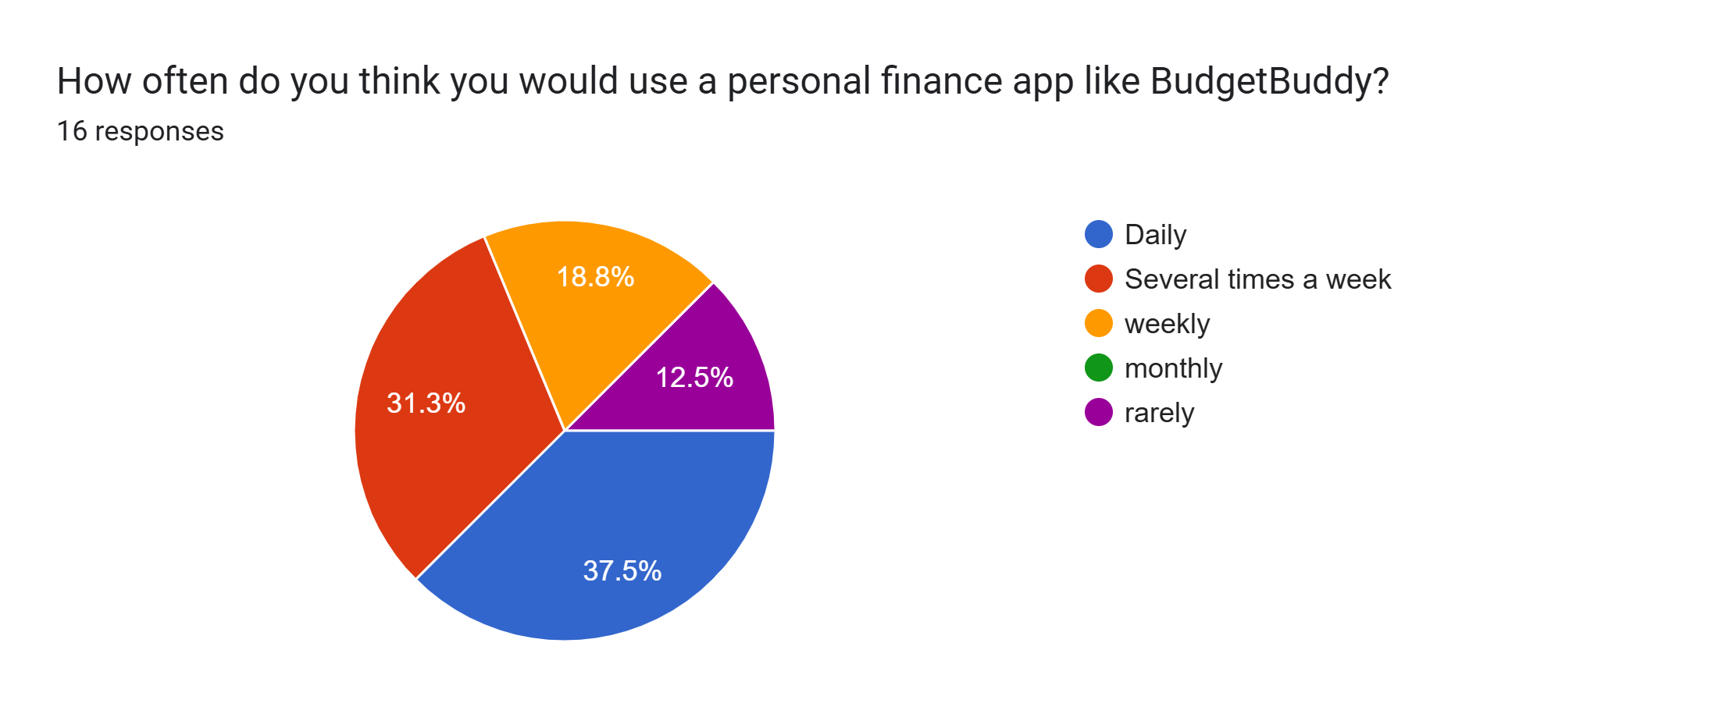
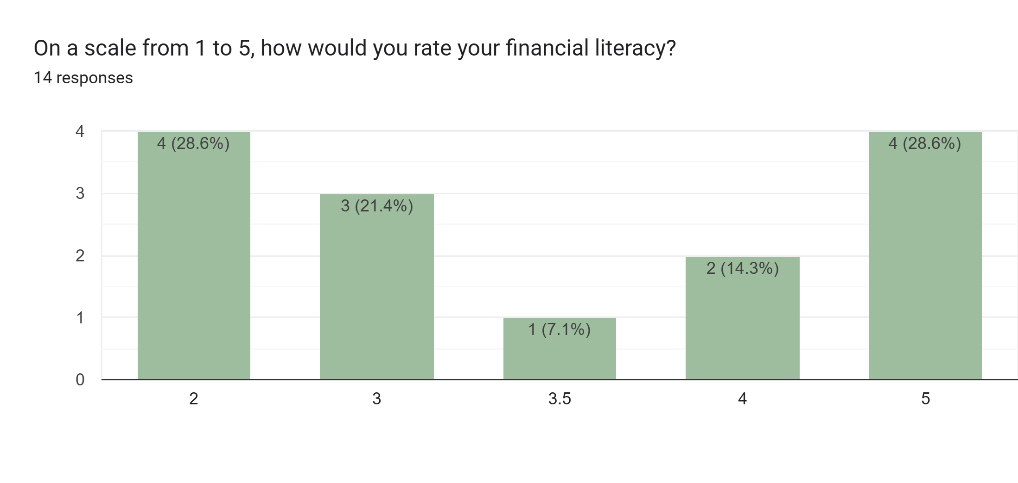
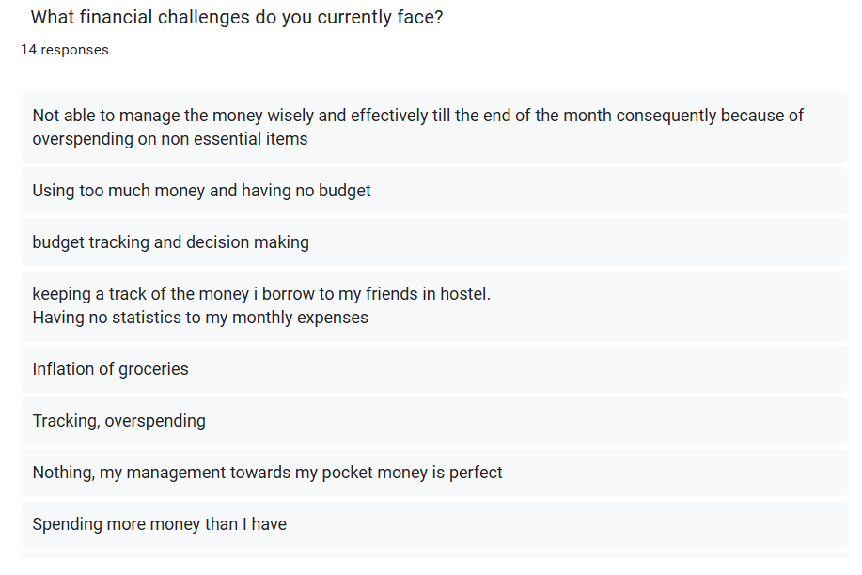
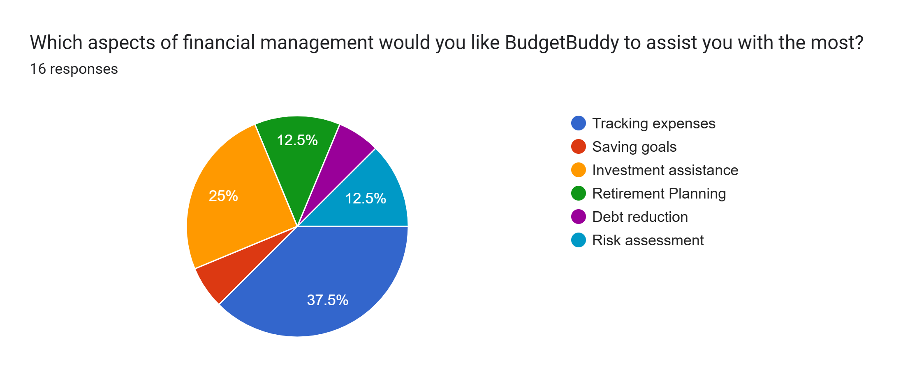
Survey
https://docs.google.com/forms/d/e/1FAIpQLSf6BzxhLxnOHJqhhEbUiSv7eLI2pkdqTC-u7OvIfyVPuSXHSQ/viewform?usp=header

Slide 11
Common Financial Challenges
Manual Data Entry and Inaccuracy: Current financial management apps often require users to manually log in their
expenses, which can be time-consuming, cumbersome, and prone to errors.
Real-Time Data and Forecasting: Users lack real-time financial tracking and forecasting tools, making it difficult to plan
effectively for the future.
User Engagement: Many financial apps struggle with user engagement because they demand frequent input and don’t provide personalized, actionable insights.
Market Needs
Financial Education and Awareness: There is a need for tools that educate users about financial literacy and management,
helping them understand and improve their financial habits.
Accessibility and Usability: The platform must be user-friendly, intuitive, and accessible across different devices and user
demographics.
Pain Points in the Industry
Privacy Concerns: Users are often hesitant to share financial data due to privacy concerns. BudgetBuddy will ensure data security and confidentiality.
Lack of Personalization: Generic financial advice can be ineffective.

Slide 12
Timeline
Week 3-4
Week 8
Tasks: Test the integration between frontend and backend, implement data visualization, and refine user interaction.
Tasks: Monitor application performance, address any post-deployment issues, and prepare for final presentation.
Week 1-2
Tasks: Finalize frontend
design, basic backend setup, and integrate essential features.
Completed: Website/app design, basic backend code, and research.
Week 5-6
Week 7
Tasks: Conduct final testing, deploy the application, and gather user feedback for improvements.
Tasks: Complete any remaining bugs or issues, finalize documentation, and prepare for deployment.

Slide 13
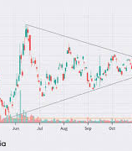
Feasibility & Scalability
Scalability
Feasibility
Market Analysis
Modular Architecture: Flask/Django and scalable databases like MongoDB/PostgreSQL
Cloud Integration
AI-Powered Customization: AI models handle multiple users with cost-efficiency
API-Driven Ecosystem: APIs and microservices allow feature expansion and third-party integrations.
Data-Driven Decisions: prioritize scalable regional growth strategies.
User Growth Strategies: Freemium models and education features attract and retain a large user base.
Seamless User Experience
Security and Compliance: Robust encryption and adherence to global standards ensure safe and trusted scaling.
Strong User Engagement
Cost-Effective Development
Data-Driven Decision Making
Partnership Opportunities
Continuous Improvement
Market Size: Global personal finance app market projected to grow at 15% annually.
Competitive Landscape: BudgetBuddy competes with Mint and YNAB, offering AI-driven insights.
Target Audience: Millennials, Gen Z, and underserved markets
Consumer Behavior: Shift. towards digital financial tools for tracking and goal-setting.
Growth Opportunities: Potential to expand internationally and through partnerships.

Slide 14

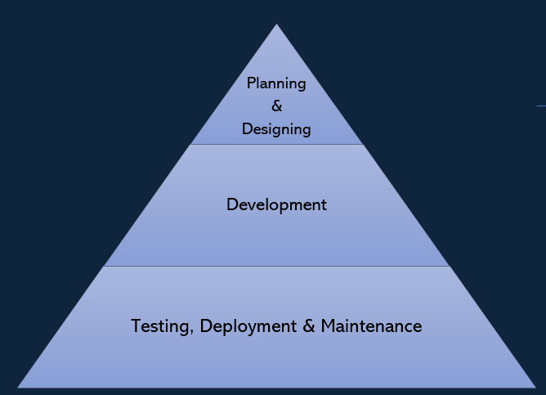

Execution
Frontend
Technology: React.js
Responsibilities
UI/UX: Create an intuitive interface with HTML, CSS, and JavaScript.
Data Visualization: Use charts and graphs to display financial data.
Interaction: Handle user input and connect with backend APIs.
Development
Testing, Deployment & Maintenance
Planning
&
Designing
Backend
Technology: Django or Flask (Python)
Responsibilities
API Development: Create RESTful APIs for data management and user interaction.
Data Storage: Manage user data and financial records in PostgreSQL or MongoDB.
Security: Ensure data encryption and user authentication.
Integration: Connect with financial data APIs and payment gateways.

Slide 15
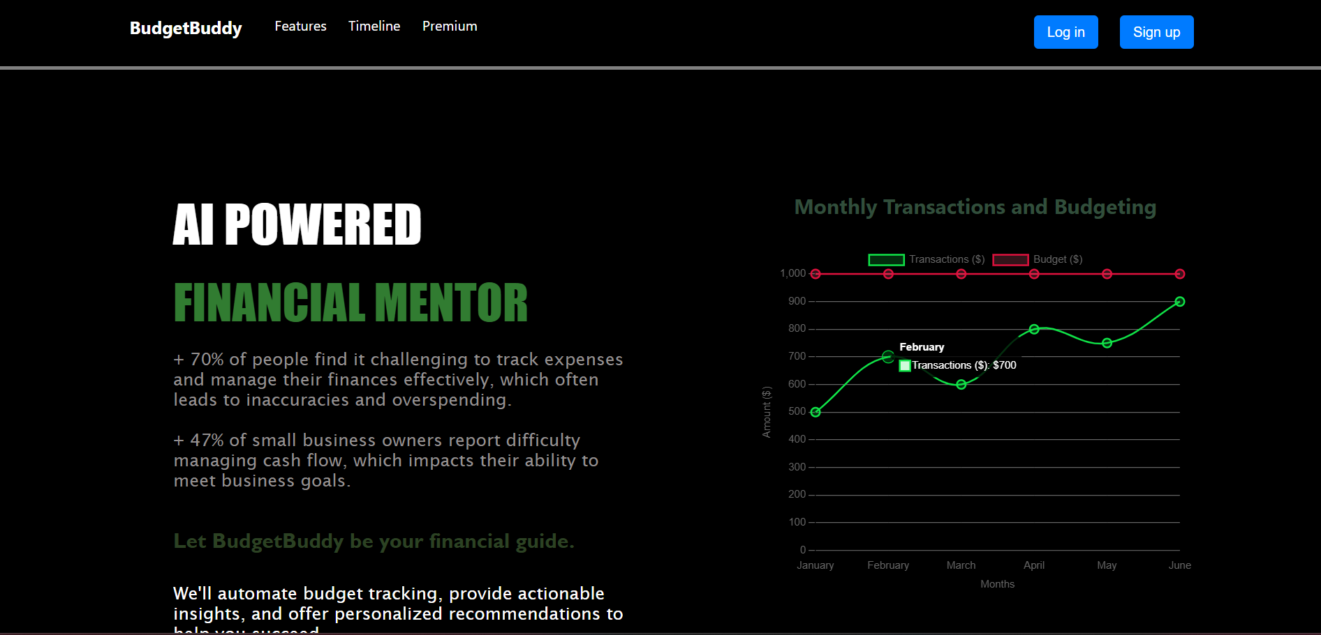
OUR WEBSITE
15

Slide 16
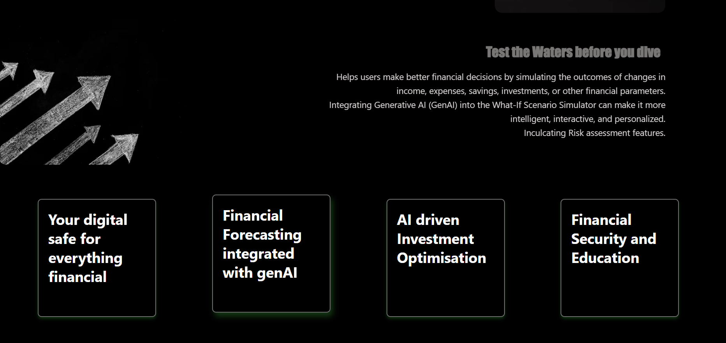
16

Slide 17
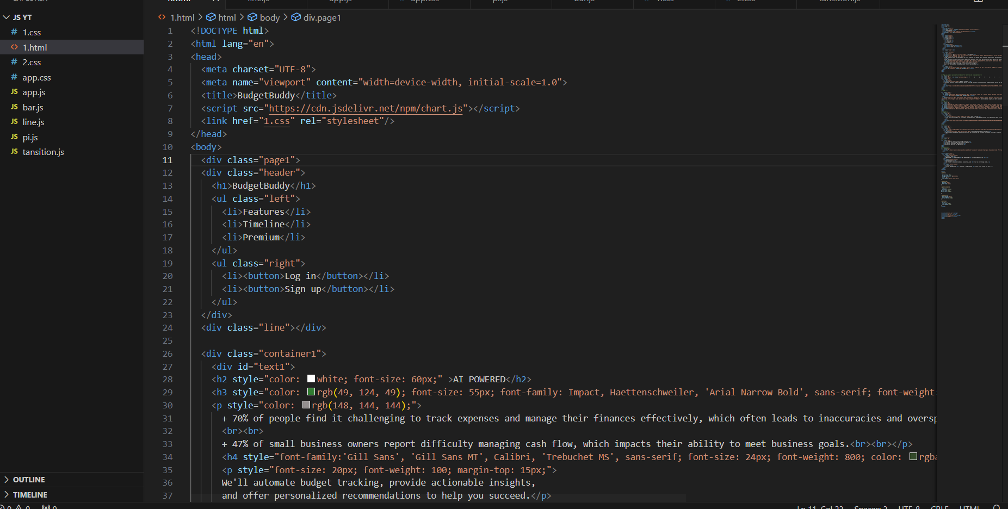
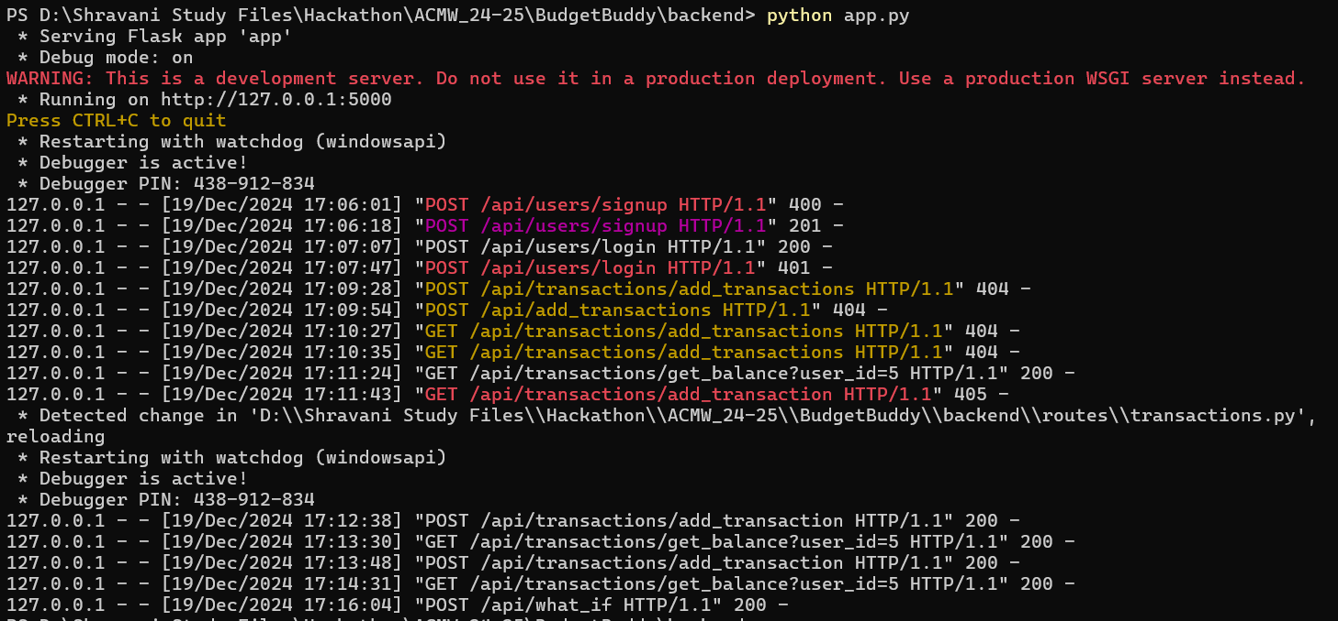
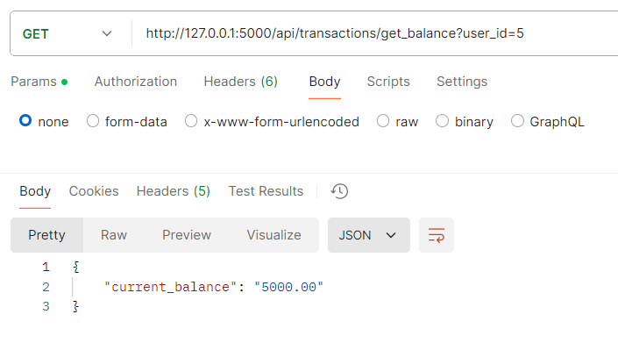
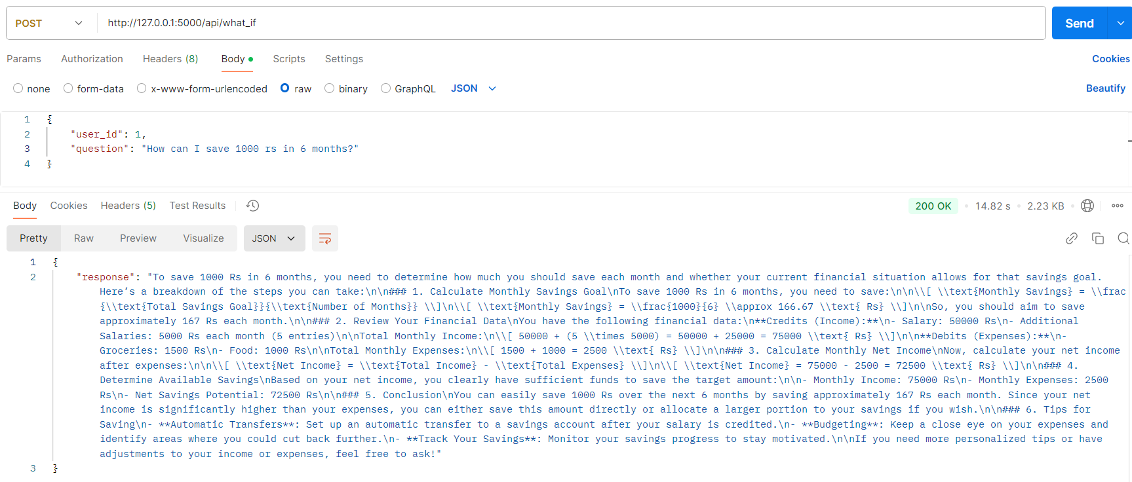
17

Slide 18
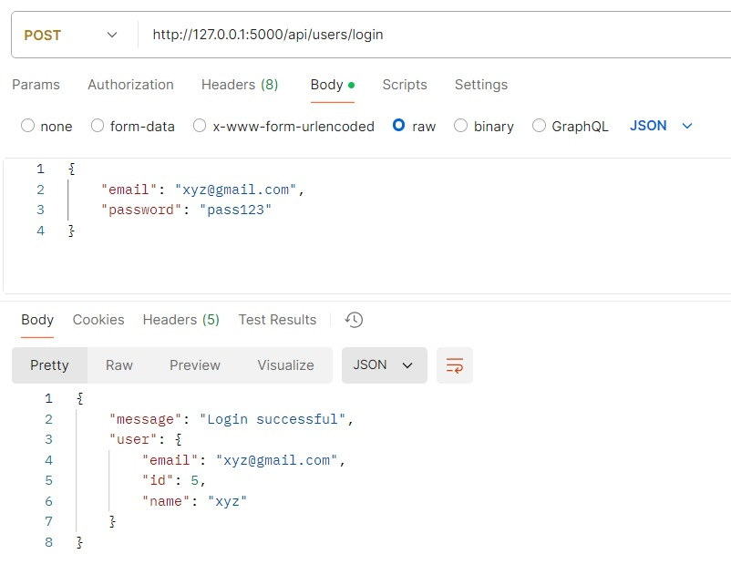
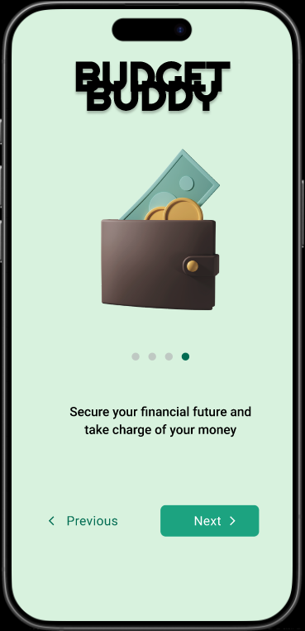
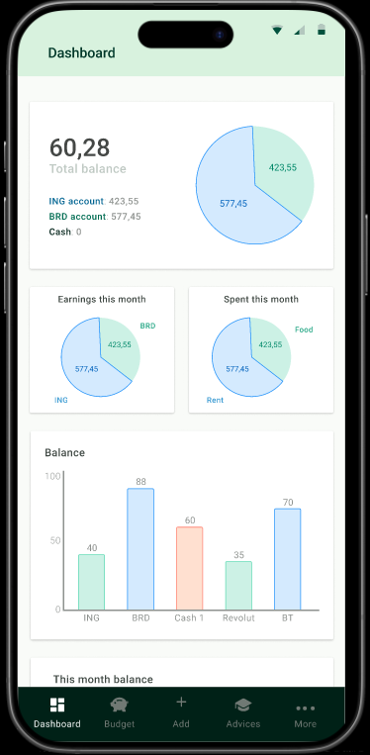
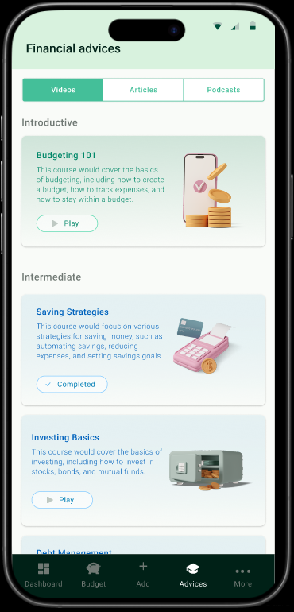
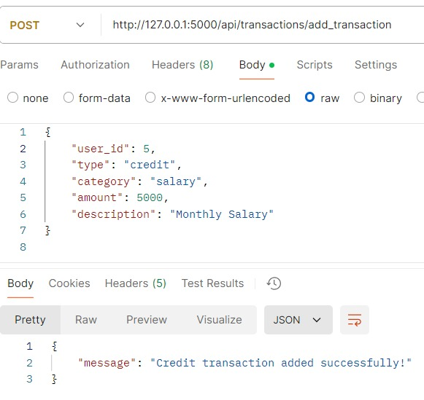

Slide 19

Societal Impact
Financial Empowerment BudgetBuddy improves financial literacy & helps individuals make informed economic decisions.
Economic Growth The platform promotes responsible financial planning and sustainable
growth at community and individual levels.
Accessibility and Inclusivity By ensuring tools are accessible, BudgetBuddy supports
financial success across diverse socioeconomic backgrounds.
Privacy and Trust Focused on data security, BudgetBuddy builds trust and
encourages broader adoption of digital financial solutions.
Community Impact BudgetBuddy empowers users to share knowledge, benefiting entire communities and reducing economic disparities.

Slide 20



Meet our team
Twinkle Tomar
1st year CCE
MIT, Manipal
Team Lead
Shravani Sanjay Sawant
Soumya Jha
2nd year CCE
MIT, Manipal
2nd year CCE
MIT, Manipal
Our team is deeply dedicated to bring BudgetBuddy to life, and we are truly grateful for the opportunity to showcase our passion and innovation at this hackathon

Slide 21




Thank you
Team Codettes

